Slide 2
Parser
Parser is a compiler that is used to break the data into smaller elements coming from lexical analysis phase.
A parser takes input in the form of sequence of tokens and produces output in the form of parse tree.
Parsing is of two types: top down parsing and bottom up parsing.

Slide 3
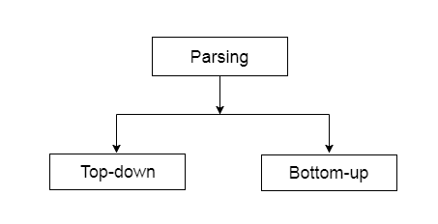

Slide 4
Top down paring
The top down parsing is known as recursive parsing or predictive parsing.
Bottom up parsing is used to construct a parse tree for an input string.
In the top down parsing, the parsing starts from the start symbol and transform it into the input symbol.

Slide 5
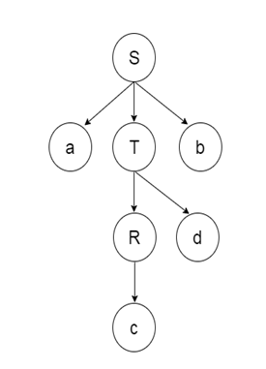
Parse Tree representation of input string "acdb" is as follows:

Slide 6
Working of top down parser
In top down technique parse tree constructs from top and input will read from left to right. In top down, In top down parser, It will start symbol from proceed to string.
It follows left most derivation.
In top down parser, difficulty with top down parser is if variable contain more than one possibility selecting 1 is difficult.

Slide 7
Working of Top Down Parser : Let’s consider an example where grammar is given and you need to construct a parse tree by using top down parser technique.

Slide 8
Example –
S -> aABe
A -> Abc | b
B -> d

Slide 9
Now, let’s consider the input to read and to construct a parse tree with top down approach.
Input –

Slide 10
abbcde
generate a input string from the grammar for top down approach.

Slide 11
First, you can start with S -> a A B e and then you will see input string a in the beginning and e in the end.
Now, you need to generate abbcde .
Expand A-> Abc and Expand B-> d.

Slide 12
Now, You have string like aAbcde and your input string is abbcde.
Expand A->b.
Final string, you will get abbcde.

Slide 13
